Slide 1

IBM Capstone Project
Arnav Sambhare

Slide 2
Choosing locations
The performance of a new business outlet is completely dependant on the location.
Good locations provide increased footfall leading to increased revenue.
This project aims to find the optimum location for opening a new restaurant.

Slide 3
Data Used
Foursquare API
Wikipedia page for Toronto's neighborhoods
Latitude and longitudes dataset of the neighborhoods

Slide 4
Data from the User
The cuisine of the restaurant to be opened
This is to find the neighborhoods which have no restaurants offering the same cuisine

Slide 5
Methodology
All the neighboring venues and points of interest are got from the Foursquare API.
Then depending on the density of the neighborhoods, a set of optimum neighborhoods is prepared
Points of Interest near all places using Foursquare API
Finding neighborhoods with no restaurants offering the same cuisine
Further, forming a dataframe of all the optimum neighborhoods.

Slide 6
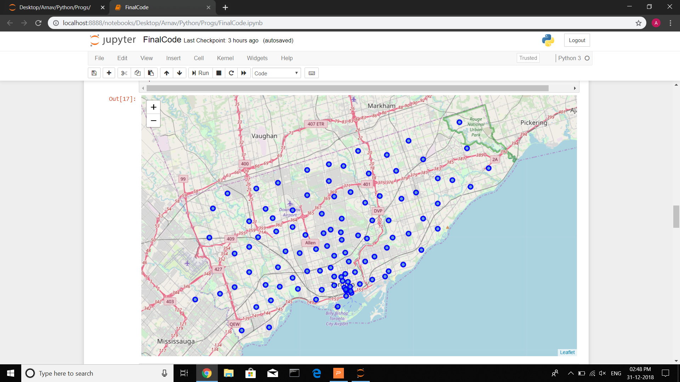
Recommendations
Other than the cuisine based recommendations, restaurants should be opened in the Toronto Downtown Area.
This area has a high density of population and also many places of interest.

Slide 7
Thank You!

